Slide 1

Deep Neural Networks for Brain Tumor Detection
Multi-Task Pipeline for Classification & Segmentation
Presented by :Alexios Petrou-P22142
Supervisor: Dr. Dimitrios Apostolou
Co-Supervisor: Dr. Eugenia Psarra
Department of Informatics
University of Piraeus
October 2025

Slide 2
Objective
MRI Image
│
▼
[ CNN / Shared Encoder ]
│
├─> Classification Head → Softmax (tumor type)
│
└─> Segmentation Head → U-Net Decoder (tumor mask)

Slide 3
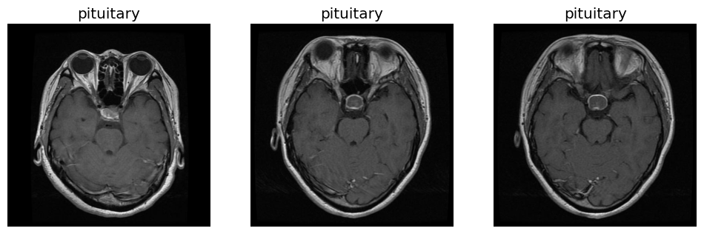
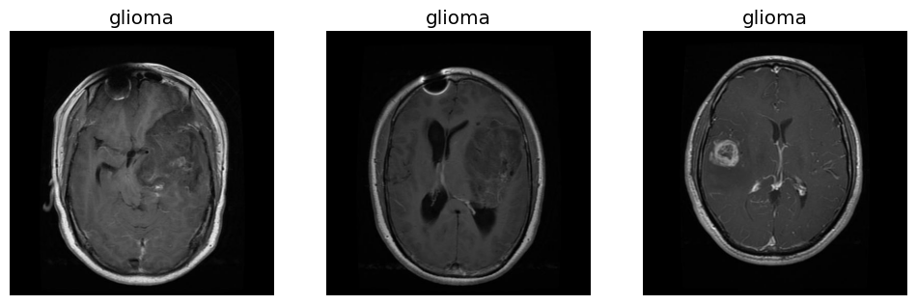
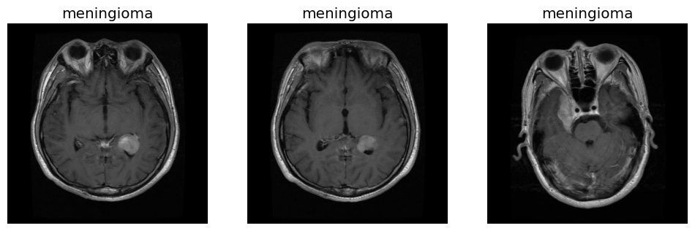
🧠 Dataset: BRISC 2025
BRISC 2025 dataset: 6,000 T1-weighted MRI slices
Tumor categories: 4 classes (glioma, meningioma, pituitary, no tumor)
Segmentation: Expert-annotated pixel-wise masks
Planes: Axial, Coronal, Sagittal
Train/Test split: 5,000 / 1,000 slices
Unique identifiers: Prevent patient data leakage
High-quality dataset suitable for multi-task deep learning

Slide 4
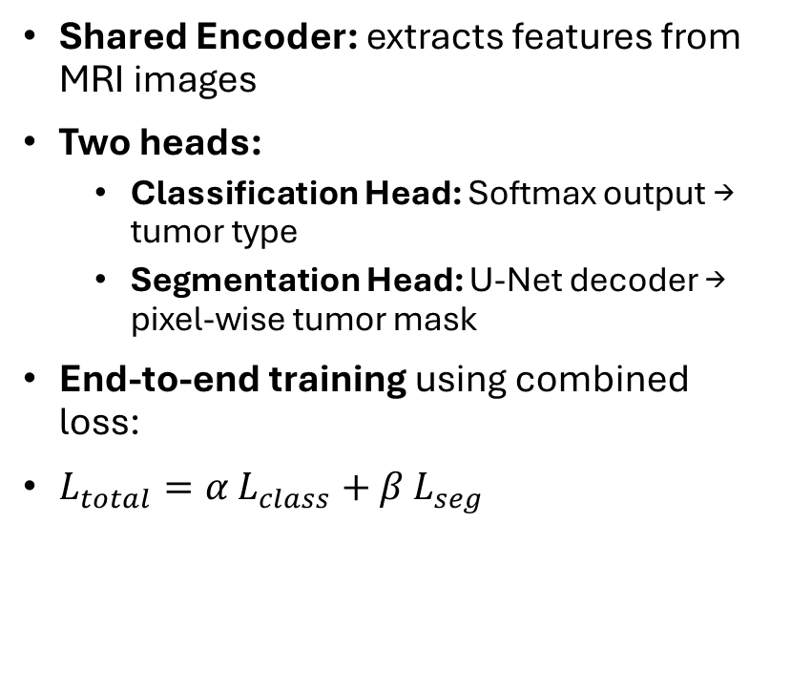
Unified Pipeline: Classification + Segmentation
Shared Encoder: extracts features from MRI images
Two heads:
  Classification Head: Softmax output → tumor type
  Segmentation Head: U-Net decoder → pixel-wise tumor mask
End-to-end training using combined loss:
$L_{total}=α L_{class}+β L_{seg}$
MRI Input
│
▼
[ Shared CNN Encoder ]
│
┌────┴────------┐
│ │
Classification Segmentation
Head Head
Softmax U-Net
Output Mask

